Slide 1


`
Schulich School of Business MMAI 5090
Week 2 : Classification metrics and naive Bayes classifier
Business applications of artificial intelligence II
Instructor: Boris Garbuzov
MMAI 5090
Summer 2021
SCHULICH SCHOOL OF BUSINESS | MMAI 5090
MODULE 1
Business applications of artificial intelligence II
2020

Slide 2
Agenda
Learning function
Classifiers
Classification metrics
Bayesian classifier
No predictors case
One and two predictors
Ideal Bayesian classification rate
Estimation of probabilities
Conditional independence. Naive Bayes
Python implementation
Questions and discussion
2 / 30

Slide 3
Classification problem

Slide 4
Classification: basic concepts
Classification is the problem of identifying to which of a set of categories (subpopulations), a new observation belongs to, on the basis of a training set of data containing observations and whose categories membership is known.
It is a two-step process such as :
Learning Step (Training Phase): Construction of Classification Model. Different Algorithms are used to build a classifier by making the model learn using the training set available.
Classification Step: Model used to predict class labels and testing the constructed model on test data and hence estimate the accuracy of the classification rules.
Content of this slide is partly borrowed from
https://www.geeksforgeeks.org/basic-concept-classification-data-mining/
4 / 30

Slide 5
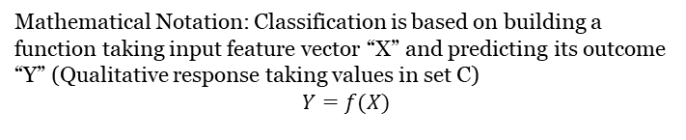
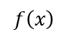
Classification: basic concepts
Mathematical Notation: Classification is based on building a function taking input feature vector “X” and predicting its outcome “Y” (Qualitative response taking values in set C)
$$Y=f(X)$$
Y
X
$$x$$
$$f\left(x\right)$$
This slide’s content is partly borrowed from
https://www.geeksforgeeks.org/basic-concept-classification-data-mining/
5 / 30

Slide 6
Classification Problems: Example “spam”
Here the response variable Y is qualitative — e.g. email is one of C = (spam, ham) (ham=good email), digit class is one of Y = {0, 1, . . . , 9}. Our goals are to:
Build a classifier Y(X) that assigns a class label from C to a future unlabeled observation X.
Assess the uncertainty in each classification
Understand the roles of the different predictors among
X = (X₁, X₂, . . . , X_{p}).
6 / 30

Slide 7
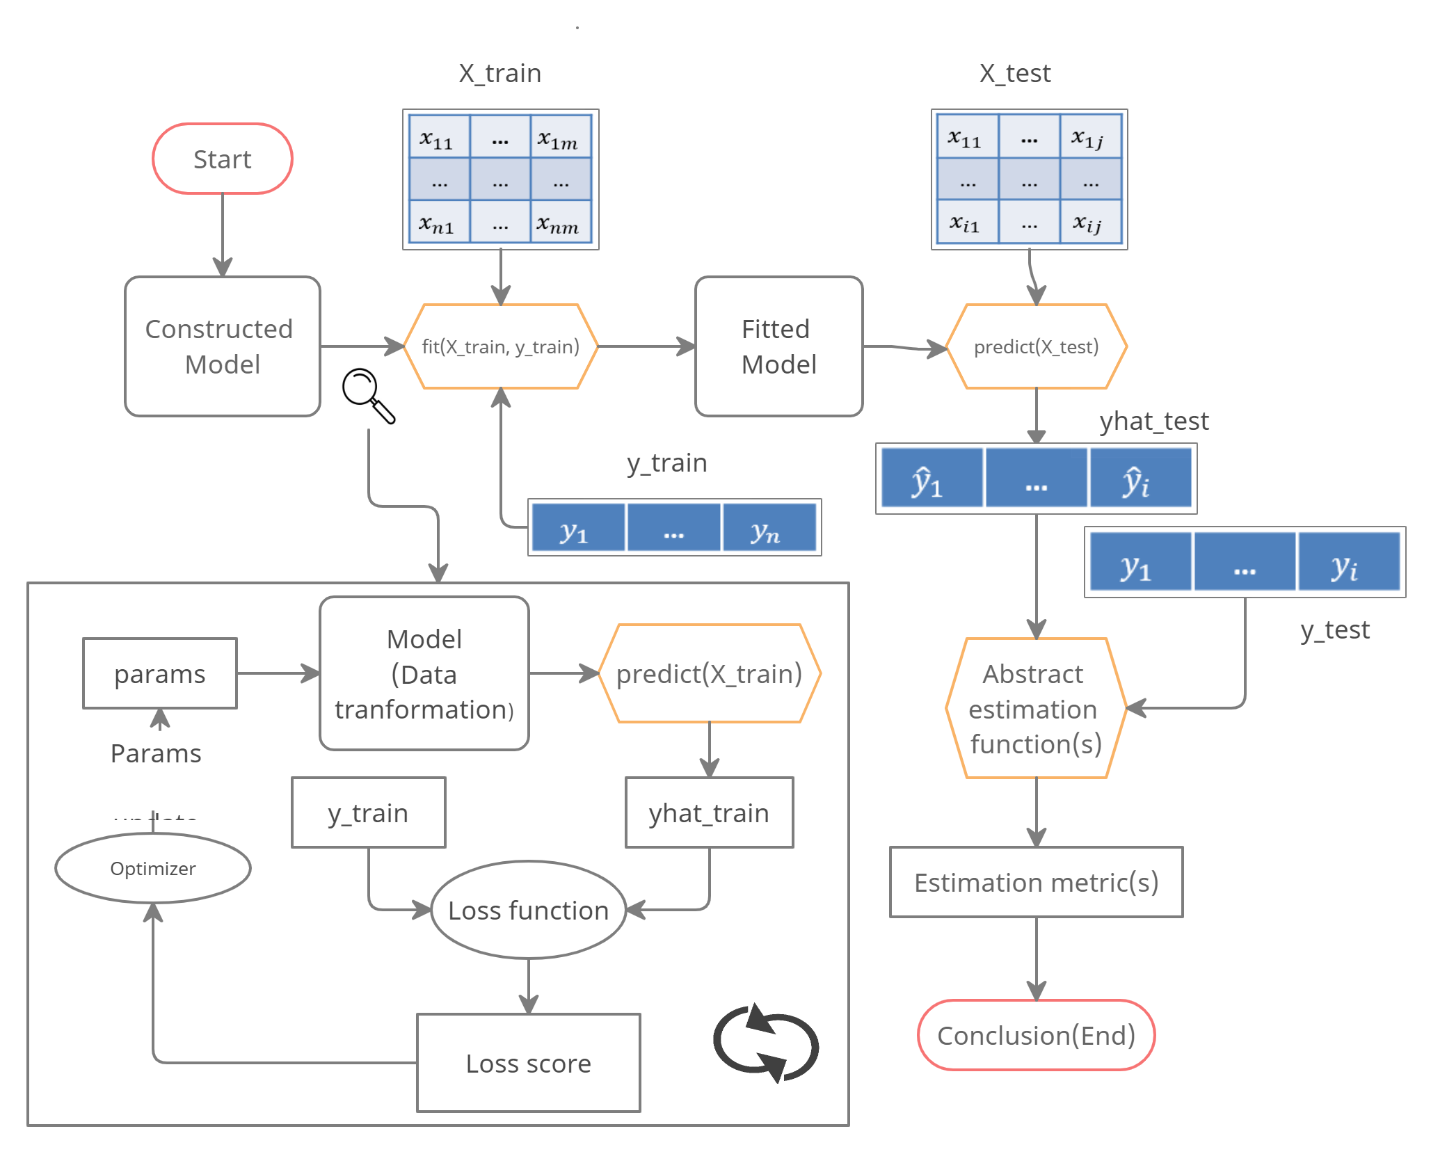
Classification flow diagram
7 / 30

Slide 8
Classification metrics

Slide 9
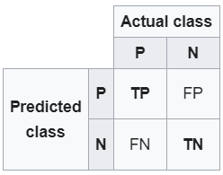
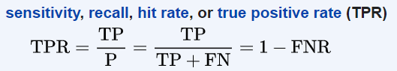
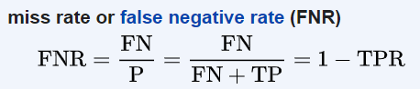
TPR & FNR
TPR
FNR
<complement>

Slide 10
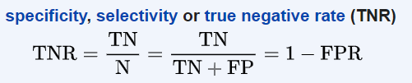
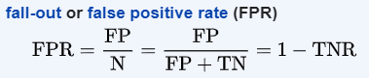
TNR & FPR
TNR
FPR
<complement>

Slide 11
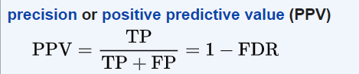
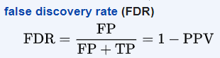
PPV & FDR
PPV
FDR
<complement>

Slide 12
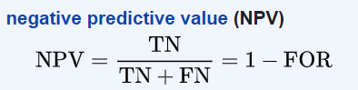
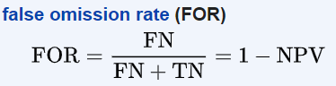
NPV & FOR
NPV
FOR
<complement>

Slide 13
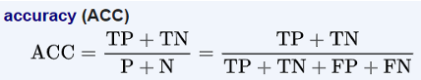
Accuracy
More interpretable metric, but useless on unbalanced sets
Accuracy

Slide 14
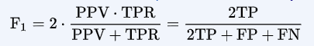
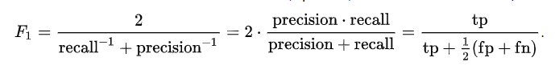
F₁ score
Is the harmonic mean of precision and recall metrics. It is also named as Dice similarity coefficient, DSC or Sørensen index
Identically to

Slide 15
Types of errors
False positive rate: The fraction of negative examples that are classified as positive — 0.2% in example.
False negative rate: The fraction of positive examples that are classified as negative — 75.7% in example.
We produced this table by classifying to class Yes if
(Default = Yes|Balance, Student) ≥ 0.5
We can change the two error rates by changing the threshold from 0.5 to some other value in [0, 1]:
(Default = Yes|Balance, Student) ≥ threshold,
and vary threshold.

Slide 16
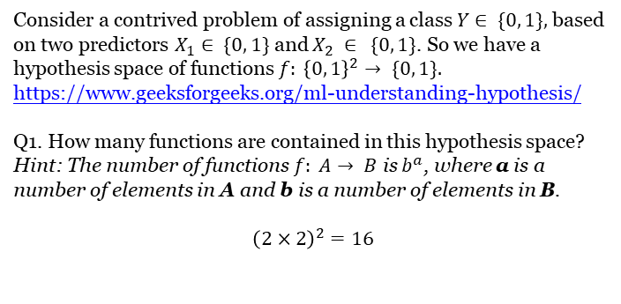
Classification metrics. Example
Consider a contrived problem of assigning a class $Y∈ \{0, 1\},$based on two predictors $X_{1}∈ \{0, 1\}$and $X_{2} ∈ \{0, 1\}$. So we have a hypothesis space of functions $f: {\left\{0, 1\right\}}^{2}→ \{0, 1\}.$
https://www.geeksforgeeks.org/ml-understanding-hypothesis/
Q1. How many functions are contained in this hypothesis space?
Hint: The number of functions $f: A→ B$ is $b^{a}$, where a is a number of elements in A and b is a number of elements in B.
$${\left(2×2\right)}^{2}=16$$

Slide 17
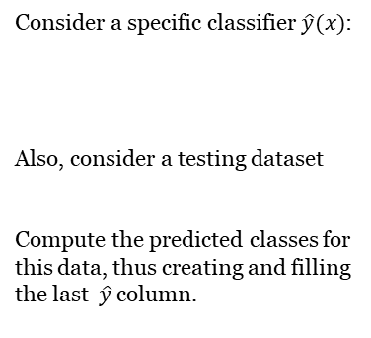
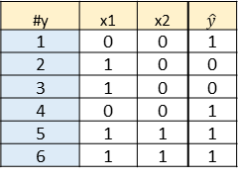
Classification metrics. Example
Consider a specific classifier $\hat{y}(x)$:
Also, consider a testing dataset
Compute the predicted classes for this data, thus creating and filling the last $\hat{y}$column.
# | x1 | x2 | yHat
1 | 0 | 0 | 1
2 | 0 | 1 | 1
3 | 1 | 0 | 0
4 | 1 | 1 | 1
#y | x1 | x2 | $$\hat{y}$$
1 | 0 | 0 | 1
2 | 1 | 0 | 0
3 | 1 | 0 | 0
4 | 0 | 0 | 1
5 | 1 | 1 | 1
6 | 1 | 1 | 1

Slide 18
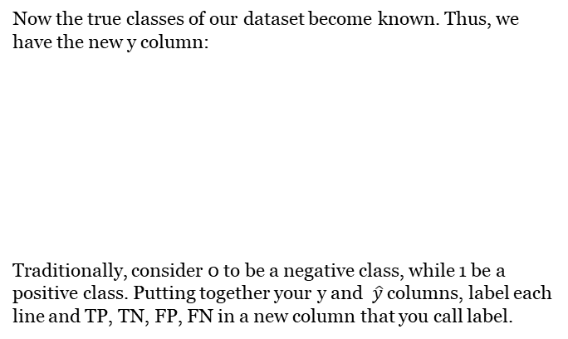
Classification metrics. Example
Now the true classes of our dataset become known. Thus, we have the new y column:
Traditionally, consider 0 to be a negative class, while 1 be a positive class. Putting together your y and $\hat{y}$ columns, label each line and TP, TN, FP, FN in a new column that you call label.
# | x1 | x2 | y
1 | 0 | 0 | 1
2 | 1 | 0 | 1
3 | 1 | 0 | 0
4 | 0 | 0 | 1
5 | 1 | 1 | 1
6 | 1 | 1 | 1

Slide 19
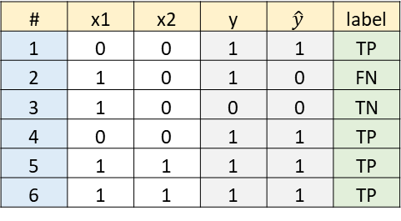
Classification metrics. Example
# | x1 | x2 | y | $$\hat{y}$$ | label
1 | 0 | 0 | 1 | 1 | TP
2 | 1 | 0 | 1 | 0 | FN
3 | 1 | 0 | 0 | 0 | TN
4 | 0 | 0 | 1 | 1 | TP
5 | 1 | 1 | 1 | 1 | TP
6 | 1 | 1 | 1 | 1 | TP

Slide 20
Classification metrics. Example
The label column in the previous question may be considered as data for the confusion matrix in a tall format. Now, count the labels and put them into a new format, thus creating the actual confusion matrix.
Compute the margins of the table in the previous questions, thus computing
(Condition N) = (N) = (number of actual Y=0) = (TN + FP)= 1+0=1
(Condition P) = (P) = (number of actual Y=1) = (FN + TP)= 1+4=5
(Predicted N) = (number of predicted Y=0) = (TN + FN)=1+1=2
(Predicted P) = (number of predicted Y=1) = (FP + TP)=0+4=4
Actual Y \ Predicted Y | Predicted 0 | Predicted 1
Actual or condition 0 | 1 | 0
Actual or condition 1 | 1 | 4

Slide 21
Classification metrics. Example
Sensitivity (recall, hit rate or true positive rate TPR) =TP/P = 4/5 = 0.8
In this case frequencies of both classes are quite similar. Comment on applicability of the metric in the previous question in case when one class is much more frequent than the other.
Specificity (selectivity or true negative rate TNR) = TN/N = 1/1 = 1
Note, this metric is not implemented in sklearn.
Precision (or positive predictive value PPV) = TP/(TP+FP)= 4/(4+0)=1
Accuracy = (TP+TN)/(P+N) = (4+1)/(4+2)= 5/6 = 0.8333

Slide 22
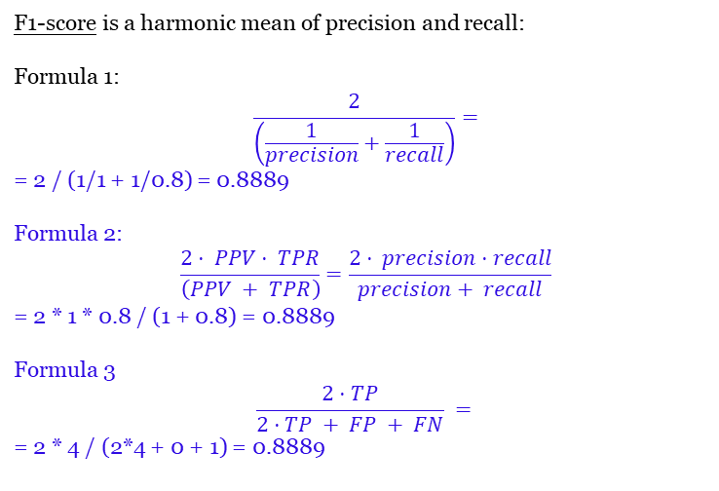
Classification metrics. Example
F1-score is a harmonic mean of precision and recall:
Formula 1:
$$\frac{2}{\left(\frac{1}{precision}+\frac{1}{recall}\right)}=$$
= 2 / (1/1 + 1/0.8) = 0.8889
Formula 2:
$$\frac{2⋅ PPV⋅ TPR}{\left(PPV + TPR\right)}=\frac{2⋅ precision⋅recall}{precision+ recall}$$
= 2 * 1 * 0.8 / (1 + 0.8) = 0.8889
Formula 3
$$\frac{2⋅TP}{2⋅TP + FP + FN} =$$
= 2 * 4 / (2*4 + 0 + 1) = 0.8889

Slide 23
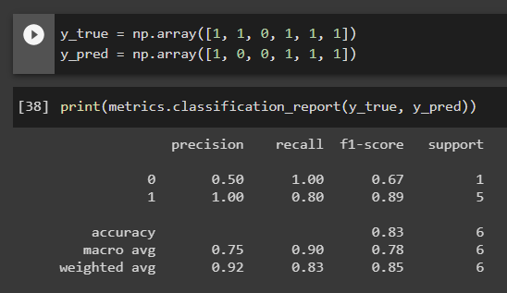
Classification metrics. Example
In Python, consider classification report, corresponding to this example. Some of these metrics we already computed. The other parts of it we will compute now step by step.

Slide 24
Classification metrics. Example
If initially we computed precision with default class to be positive, now, according to above classification report, we need to compute class-wise precision:
precision(0) (or negative predictive value NPV)=TN/(TN+FN)= 1/(1+1)=0.5
precision(1) (or positive predictive value PPV) = TP/(TP+FP)= 4/(4+0)=1
The Python classification report contains its macro average =
= (precision(0) + precision(1))/2 = (0.5 + 1)/2 = 0.75
As you could see, the classification report contains the rightmost support column. It contains absolute prior frequencies of classes. Compute
support_0 = number of points that actually belong to class 0 =1 + 0 = 1
and
support_1 = number of points that actually belong to class 1 = 1 + 4 = 5
Compute the full support = support_0 + support_1= 1+5 = 6

Slide 25
Classification metrics. Example
Compute class prior relative frequencies that will be used as weights for further averaging.
weight_0 = support_0 / support = 1/6 = 0.1667
weight_1 = support_1 / support = 5/6 = 0.8333
Check weight_0 + weight_1 = 0.1667 + 0.8333 = 1
The bottom row of the classification report contains weighted averages of the metrics. They use the weights that we already computed.
Compute the weighted precision = weight_0 * precision_0 + weight_1 * precision_1=0.1667*0.5 + 0.8333*1 = 0.9167

Slide 26
Classification metrics. Example
Before we computed recall in its default sense as sensitivity, hit rate or true positive rate TPR =TP/P. Now we call that quantity recall_1, and we also need recall_0. We write both:
recall_0 = TN/N = 1/1 = 1
recall_1 = TP/P = 4/5 = 0.8
Now compute their arithmetic mean, called macro average in Python's classification report
macro avg recall = (recall_0 + recall_1) / 2= (1 + 0.8) / 2 = 0.9
Also we compute the weighted average recall = weight_0 * recall_0 + weight_1 * recall_1= 0.1667*1 + 0.8333*0.8 = 0.8333

Slide 27
Classification metrics. Example
Before we computed f1-score as a harmonic mean of precision and recall. Now we say, it was a default f1-score with respect to class 1, and we also want its class 0 counterpart. Write both
f1_0 = 2 / (1/precision_0 + 1/recall_0) = 2 / (1/0.5 + 1/1) = 0.6667
f1_1 = 2 / (1/precision_1 + 1/recall_1) = 2 / (1/1 + 1/0.8) = 0.8889
Now compute their arithmetic mean, called macro average in Python's classification report:
macro avg f1 = (f1_0 + f1_1) / 2 = (0.67+0.89)/2 = 0.78
Now compute f1 weighted average, listed in the botton line of Python's classification report:
weighted avg f1 = w_0*f1_0 + w_1*f1_1 = 1/6*0.67 + 5/6*0.89 = 0.8533

Slide 28
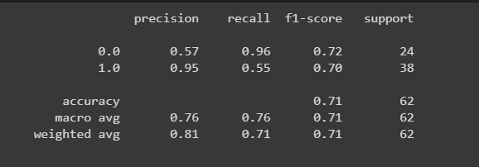
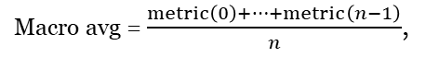
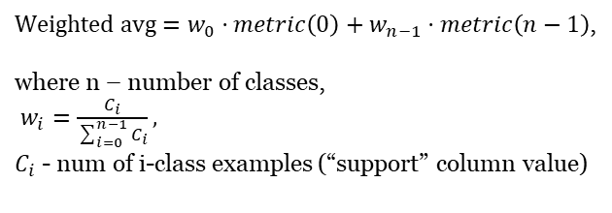
Classification report
Macro avg = $\frac{metric\left(0\right)+…+metric\left(n−1\right)}{n}$,
$Weighted avg=w_{0}⋅metric\left(0\right)+w_{n−1}⋅metric\left(n−1\right)$,
where n – number of classes,
$w_{i}=\frac{C_{i}}{\sum_{i=0}^{n−1}{C_{i}}},$
$C_{i}$ - num of i-class examples (“support” column value)

Slide 29
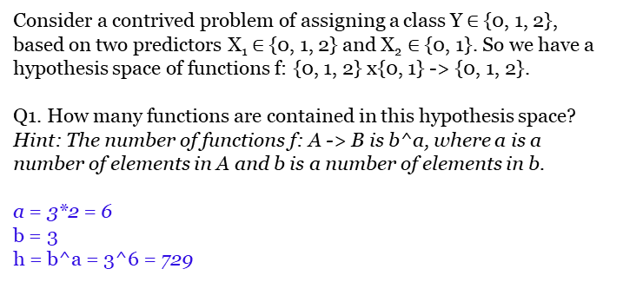
Classification metrics. 3-class example
Consider a contrived problem of assigning a class Y $∈${0, 1, 2}, based on two predictors X₁ $∈${0, 1, 2} and X₂ $∈$ {0, 1}. So we have a hypothesis space of functions f: {0, 1, 2} x{0, 1} -> {0, 1, 2}.
Q1. How many functions are contained in this hypothesis space?
Hint: The number of functions f: A -> B is b^a, where a is a number of elements in A and b is a number of elements in b.
a = 3*2 = 6
b = 3
h = b^a = 3^6 = 729
https://www.geeksforgeeks.org/ml-understanding-hypothesis/

Slide 30
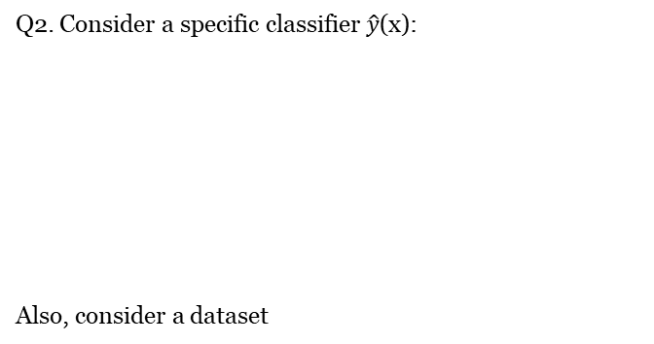
Classification metrics. 3-class example
Q2. Consider a specific classifier $\hat{y}$(x):
Also, consider a dataset
# | x1 | x2 | yHat
1 | 0 | 0 | 0
2 | 0 | 1 | 1
3 | 1 | 0 | 2
4 | 1 | 1 | 0
5 | 2 | 0 | 1
6 | 2 | 1 | 2
# | x1 | x2
1 | 0 | 0
2 | 2 | 0
3 | 1 | 0
4 | 0 | 0
5 | 2 | 1
6 | 1 | 1
7 | 1 | 1

Slide 31
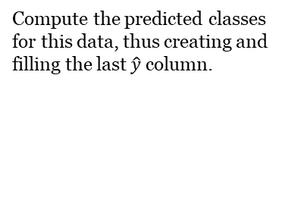
Classification metrics. 3-class example
# | x1 | x2 | yHat
1 | 0 | 0 | 0
2 | 2 | 0 | 1
3 | 1 | 0 | 2
4 | 0 | 0 | 0
5 | 2 | 1 | 2
6 | 1 | 1 | 0
7 | 1 | 1 | 0
Compute the predicted classes for this data, thus creating and filling the last $\hat{y}$ column.

Slide 32
Classification metrics. 3-class example
# | x1 | x2 | y
1 | 0 | 0 | 2
2 | 2 | 0 | 1
3 | 1 | 0 | 0
4 | 0 | 0 | 2
5 | 2 | 1 | 1
6 | 1 | 1 | 0
7 | 1 | 1 | 2
Q3. Now the true classes of our dataset become known. Thus, we have the new y column:

Slide 33
Classification metrics. 3-class example
# | x1 | x2 | y | yHat
1 | 0 | 0 | 2 | 0
2 | 2 | 0 | 1 | 1
3 | 1 | 0 | 0 | 2
4 | 0 | 0 | 2 | 0
5 | 2 | 1 | 1 | 2
6 | 1 | 1 | 0 | 0
7 | 1 | 1 | 2 | 0
# | y | yHat
1 | 2 | 0
2 | 1 | 1
3 | 0 | 2
4 | 2 | 0
5 | 1 | 2
6 | 0 | 0
7 | 2 | 0
Put together your y and yHat columns, disregarding x columns for further considerations.

Slide 34
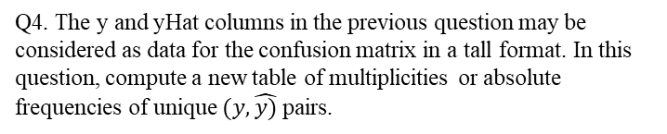
Classification metrics. 3-class example
Q4. The y and yHat columns in the previous question may be considered as data for the confusion matrix in a tall format. In this question, compute a new table of multiplicities or absolute frequencies of unique $(y, \hat{y)}$pairs.
# | y | yHat | multiplicity
1 | 0 | 0 | 1
2 | 0 | 1 | 0
3 | 0 | 2 | 1
4 | 1 | 0 | 0
5 | 1 | 1 | 1
6 | 1 | 2 | 1
7 | 2 | 0 | 3
8 | 2 | 1 | 0
9 | 2 | 2 | 0
 |  |  | 7 | sum

Slide 35
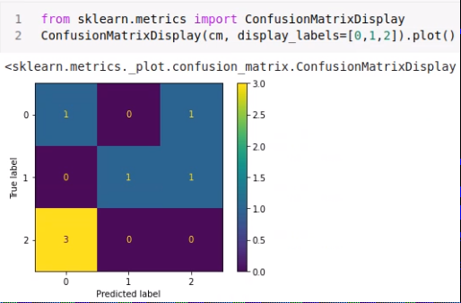
Classification metrics. 3-class example
Q5. Now put this frequency table in a new format of a contingency table, thus creating the actual multi-class confusion matrix.
Actual Y \ Predicted Y | Predicted 0 | Predicted 1 | Predicted 2
Actual or condition 0 | 1 | 0 | 1
Actual or condition 1 | 0 | 1 | 1
Actual or condition 2 | 3 | 0 | 0

Slide 36
Classification metrics. 3-class example
Q6. Compute the margins of the table in the previous questions, thus computing
(Condition 0) = (number of actual Y=0) = (0 row sum) = freq00 + freq01 + freq02
(Condition 1) = (number of actual Y=1) = (1 row sum) = freq10 + freq11 + freq12
(Condition 2) = (number of actual Y=2) = (2 row sum) = freq20 + freq21 + freq22
(Predicted 0) = (number of \hat{Y}=0) = (0 col sum) = freq00 + freq10 + freq20
(Predicted 1) = (number of \hat{Y}=1) = (1 col sum) = freq01 + freq11 + freq21
(Predicted 2) = (number of \hat{Y}=2) = (2 col sum) = freq02 + freq12 + freq22
(Condition 0) = 1 + 0 + 1 = 2
(Condition 1) = 0 + 1+ 1 = 2
(Condition 2) = 3 + 0 + 0 = 3
(Predicted 0) = 1 + 0 + 3 = 4
(Predicted 1) = 0 + 1 + 0 = 1
(Predicted 2) = 1 + 1 + 0 = 2

Slide 37
Classification metrics. 3-class example
Q6. Compute the margins of the table in the previous questions, thus computing
(Condition 0) = (number of actual Y=0) = (0 row sum) = freq00 + freq01 + freq02
(Condition 1) = (number of actual Y=1) = (1 row sum) = freq10 + freq11 + freq12
(Condition 2) = (number of actual Y=2) = (2 row sum) = freq20 + freq21 + freq22
(Predicted 0) = (number of \hat{Y}=0) = (0 col sum) = freq00 + freq10 + freq20
(Predicted 1) = (number of \hat{Y}=1) = (1 col sum) = freq01 + freq11 + freq21
(Predicted 2) = (number of \hat{Y}=2) = (2 col sum) = freq02 + freq12 + freq22
(Condition 0) = 1 + 0 + 1 = 2
(Condition 1) = 0 + 1+ 1 = 2
(Condition 2) = 3 + 0 + 0 = 3
(Predicted 0) = 1 + 0 + 3 = 4
(Predicted 1) = 0 + 1 + 0 = 1
(Predicted 2) = 1 + 1 + 0 = 2
Actual Y \ Predicted Y | Predicted 0 | Predicted 1 | Predicted 2 | row sums
Actual or condition 0 | 1 | 0 | 1 | 2
Actual or condition 1 | 0 | 1 | 1 | 2
Actual or condition 2 | 3 | 0 | 0 | 3
col sums | 4 | 1 | 2 | 7

Slide 38
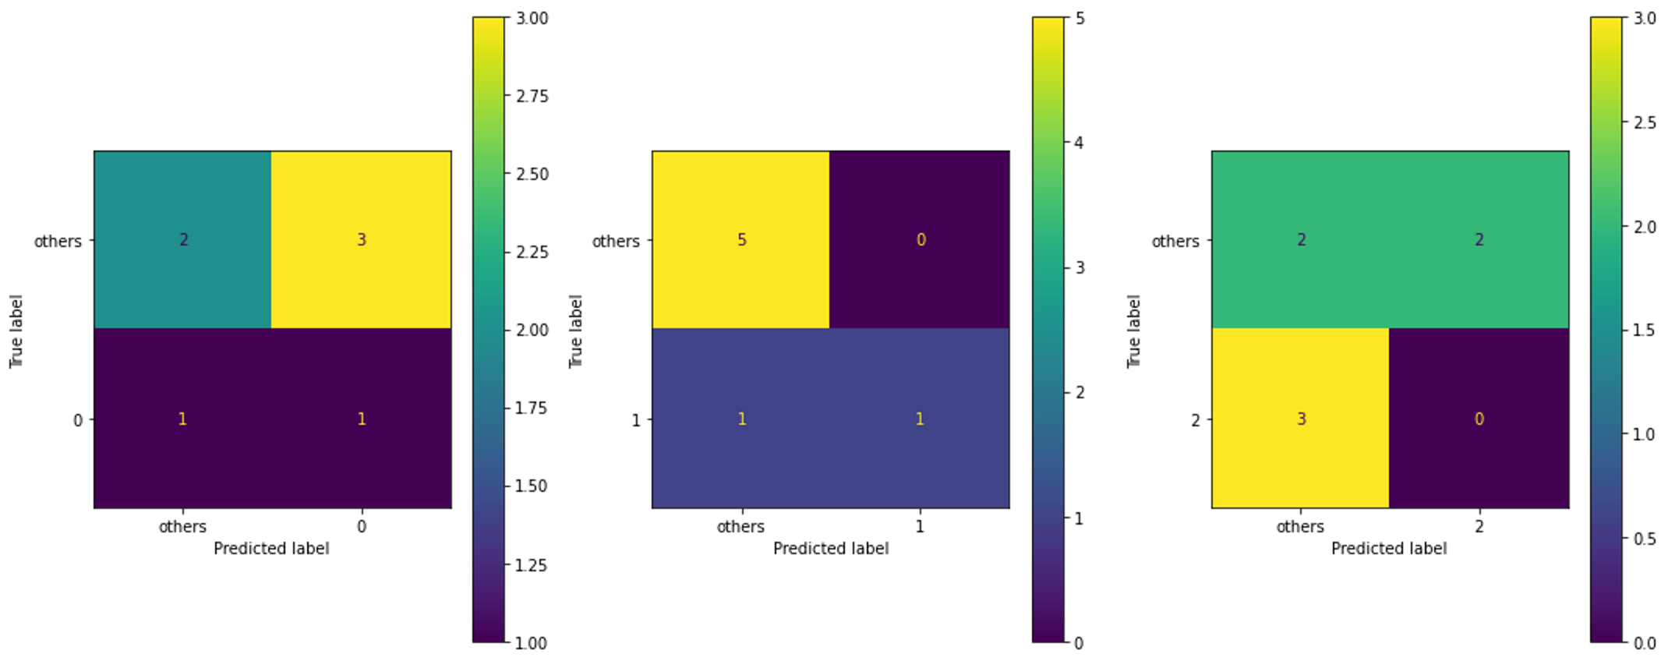
Classification metrics. 3-class example
Q7. Consider the following code:
from sklearn.metrics import multilabel_confusion_matrix
mcm = multilabel_confusion_matrix(df['y'], df['yHat'])
mcm
It prints the following 3 matrices:
array([[[2, 3], [1, 1]],
[[5, 0], [1, 1]],
[[2, 2], [3, 0]]])
It can be visualized like this:

Slide 39
Classification metrics. 3-class example
We will justify all their entries by hand. In this question, consider two-class version of our problem: a union of classes 1 and 2 against class 0. Compute the corresponding confusion matrix.
Actual Y \ Predicted Y | Predicted 1, 2 | Predicted 0 | row sums
Actual or condition 1, 2 | 2 | 1 | 5
Actual or condition 0 | 1 | 4 | 2
col sums | 3 | 4 | 7
Note: We follow the convention of multilabel_confusion_matrix function to put all but one class first, and the single class second.

Slide 40
Classification metrics. 3-class example
Q8. In the similar way, compute the confusion matrix of a union of classes 0 and 2 against class 1.
Actual Y \ Predicted Y | Predicted 0, 2 | Predicted 1 | row sums
Actual or condition 0, 2 | 5 | 0 | 5
Actual or condition 1 | 1 | 1 | 2
col sums | 6 | 1 | 7

Slide 41
Classification metrics. 3-class example
Q9. In the similar way, compute the confusion matrix of classes 0 and 1 against class 2.
Actual Y \ Predicted Y | Predicted 0, 1 | Predicted 2 | row sums
Actual or condition 0, 1 | 2 | 2 | 4
Actual or condition 2 | 3 | 0 | 3
col sums | 5 | 2 | 7

Slide 42
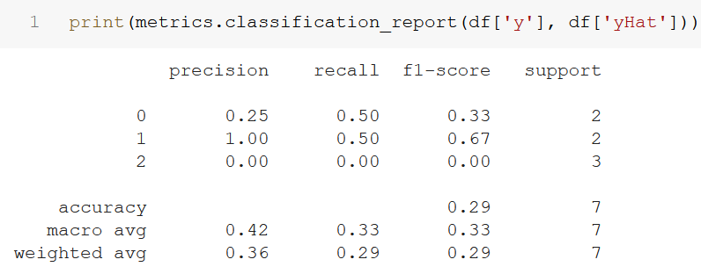
Classification metrics. 3-class example
Q10. Consider the following classification report for this example.
To understand it, we will recompute all of its numbers step by step. In this question, we focus on the rightmost support column of this report. It contains absolute frequencies of each class. They correspond predicted counts, or to column sums of the confusion matrix. Compute
support_0 = 1 + 0 + 1 = 2
support_1 = 0 + 1 + 1 = 2
support_2 = 3 + 0 + 0 = 3

Slide 43
Classification metrics. 3-class example
Q11. Compute the full support = support_0 + support_1 + support_2
4+1+2 = 7

Slide 44
Classification metrics. 3-class example
Q12. Compute class prior relative frequencies that will be used as weights for further averaging.
weight_0 = support_0 / support
weight_1 = support_1 / support
weight_2 = support_2 / support
weight_0 = 2/7 = 0.2857
weight_1 = 2/7 = 0.2857
weight_2 = 3/7 = 0.4286
Q13. Check weight_0 + weight_1 =
2/7 + 2/7 + 3/7 = 1

Slide 45
Classification metrics. 3-class example
Q14. Compute class-wise precision:
precision_0 = (truly predicted 0) / (predicted 0) = ?
precision_1 = (truly predicted 1) / (predicted 1) = ?
precision_2 = (truly predicted 2) / (predicted 2) = ?
precision_0 = 1/4 = 0.25
precision_1 = 1/1 = 1
precision_2 = 0/3 = 0

Slide 46
Classification metrics. 3-class example
Q14. Compute class-wise precision:
precision_0 = (truly predicted 0) / (predicted 0) = ?
precision_1 = (truly predicted 1) / (predicted 1) = ?
precision_2 = (truly predicted 2) / (predicted 2) = ?
precision_0 = 1/4 = 0.25
precision_1 = 1/1 = 1
precision_2 = 0/3 = 0
Q15. Compute macro average precision =
= (precision_0 + precision_1 + precision_2) / 3 = 3 ?
(0.25 + 1 + 0) / 3 = 0.4167

Slide 47
Classification metrics. 3-class example
Q16. Compute weighted average precision =
weight_0*precision_0 + weight_1*precision_1 + weight_2*precision_2 = ?
2/7*0.25 + 2/7*1 + 3/7*0 = 0.3571
Q17.
Compute class-wise recall:
recall_0 = (truly predicted 0) / (condition 0) = ?
recall_1 = (truly predicted 1) / (condition 1) = ?
recall_2 = (truly predicted 2) / (condition 2) = ?
recall_0 = 1 / 2 = 0.5
recall_1 = 1 / 2 = 0.5
recall_2 = 0 / 3 = 0

Slide 48
Classification metrics. 3-class example
Q18. Compute macro average recall =
= (recall_0 + recall_1 + recall_2) / 3 = ?
(0.5 + 0.5 + 0) / 3 = 0.3333
Q19. Compute weighted average recall =
weight_0*recall_0 + weight_1*recall_1 + weight_2*recall_2 = ?
2/7*0.5 + 2/7*0.5 + 3/7*0 = 0.2857

Slide 49
Classification metrics. 3-class example
Q20. Compute class-wise F1-scores as harmonic means of class-wise precision and recall:
f1_0 = H(precision_0, recall_0) = ?
f1_1 = H(precision_1, recall_1) = ?
f1_2 = H(precision_2, recall_2) = ?
f1_0 = H(0.25, 0.5) = 2*0.25*0.5/(0.25+0.5) = 0.3333
f1_1 = H(1, 0.5) = 2*1*0.5/(1+0.5) = 0.6667
f1_2 = H(0, 0) = 0
Q21. Compute macro average f1-score =
= (f1_0 + f1_1 + f1_2) / 3 = ?
(0.33 + 0.67 + 0) / 3 = 0.3333

Slide 50
Classification metrics. 3-class example
Q22. Compute weighted average f1-score =
weight_0*f1_0 + weight_1*f1_1 + weight_2*f1_2 = ?
2/7*0.33 + 2/7*0.67 + 3/7*0 = 0.2857
Q23. Compute accuracy = (truly predicted) / all
accuracy = (1 + 1 + 0) / 7 = 0.2857

Slide 51
Bayes classifier

Slide 52
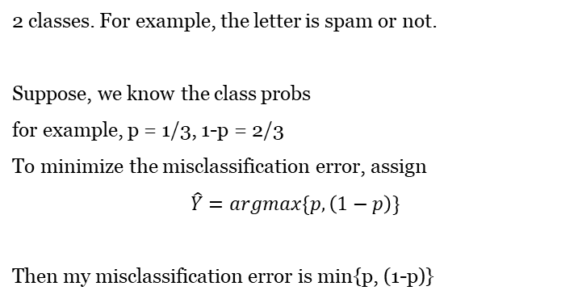
Ideal prior
p | 1-p

Slide 53
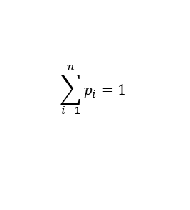
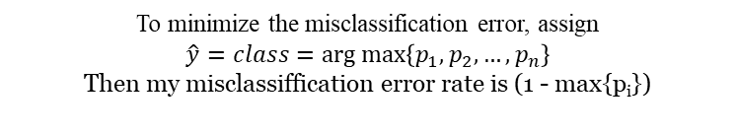
Ideal prior classifier
Class | C₁ | C₂ | … | C_{n}
Probability | p₁ | p₂ | … | p_{n}

Slide 54
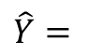
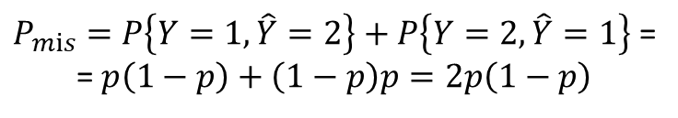
Ideal prior
Let us compare this choice to another tempting solution to randomize my decision independently, assigning
{
1, p
2, 1-p
Here p is the same true known P{Y=1}.
Then the probability of misclassification

Slide 55
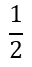
Ideal prior
determinstic ≤ randomized
0
1
p
Since there is no x, the posterior probability is just prior

Slide 56
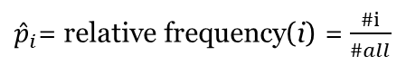
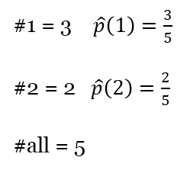
Estimating prior probabilities
1
1
2
2
1

Slide 57
Ideal Bayes
Bayes classifier on Wiki
Probability space
Suppose, as before, we have 2 classes, and X predictor with 2 values. For example, presence of the word "free" in the letter. The minimal settings for Bayes classifier. Let the prior distribution of Y be given as before.
y₂
Ω
y₁
x
x₁
x₂
π₁=p | π₂=1-p
Let the conditional probabilities be given on top of it

Slide 58
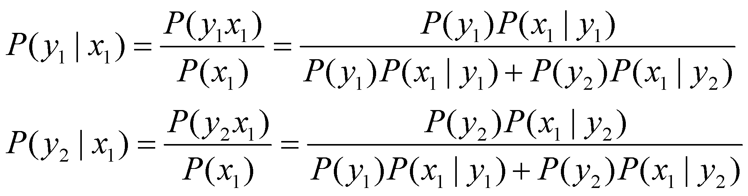
Ideal Bayes
Y\X | x₁ | x₂
y₁ | P(X=x₁|Y=y₁) | P(x₂|y₁)
y₂ | P(x₁|y₂) | P(x₂|y₂)
In fact, only half should be given.
P(x₂|y₁)=1-P(x₁|y₁)
P(x₂|y₂)=1-P(x₁|y₂)
Then the posterior probabilities can be computed by Bayes's theorem
Same denominator. Compare two numerators

Slide 59
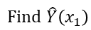
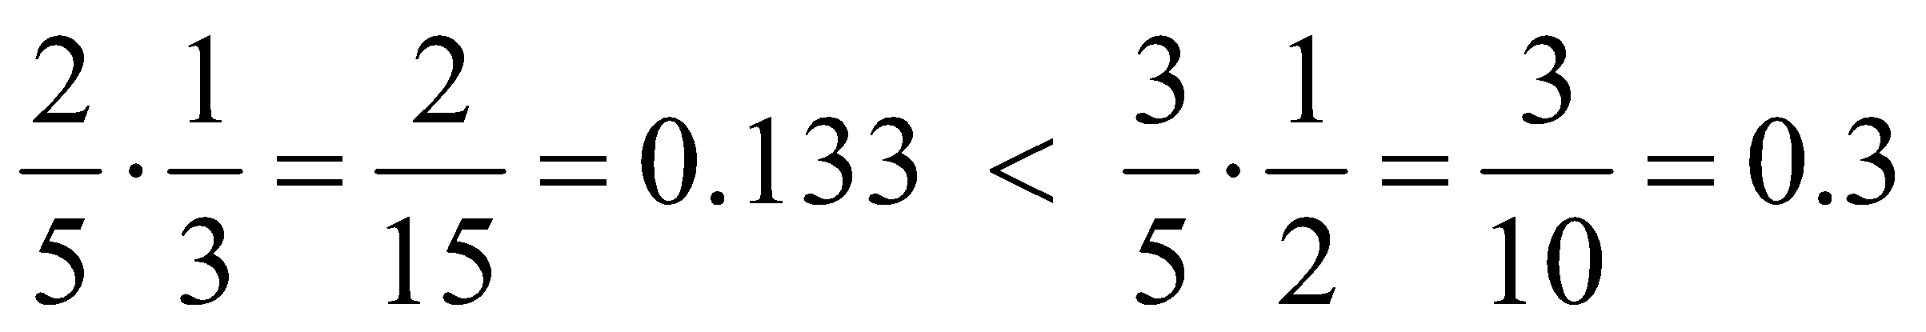



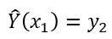



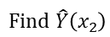
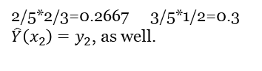
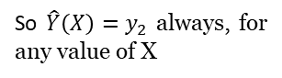
Ideal Bayes
Choose max
Y\X | x₁ | x₂
y₁ | P(X=x₁|Y=y₁) | P(x₂|y₁)
y₂ | P(x₁|y₂) | P(x₂|y₂)
So I choose y_{2,} and my prediction is
Therefore, X is not a useful predictor. It does not discriminate Y. And our misclassification probability, for this distribution,
as before is just a minimal of two prior values = 2/5

Slide 60


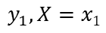
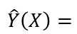
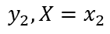

Ideal Bayes
Take another example
x₁: 2/5 * 1/3 = 0,1333 : y₁
3/5 * 1/10 = 0,06 : y₂
So now we choose y₁, when X= x₁
Now for x₂: 2/5 * 2/3 = 0.2667 : y₁
3/5 * 9/10 = 0.54 : y₂
Here we keep our choice of y₂, and the Bayes classifier is
Y\X | x₁ | x₂
y₁ | P(X=x₁|Y=y₁) | P(x₂|y₁)
y₂ | P(x₁|y₂) | P(x₂|y₂)
{
And the misclassification error by disjoint additivity

Slide 61
Bayes Error Rate
The Bayes error rate refers to the lowest possible error rate that could be achieved if somehow we knew exactly what the “true” probability distribution of the data looked like.
On test data, no classifier (or stat. learning method) can get lower error rates than the Bayes error rate.
Of course in real life problems the Bayes error rate can’t be calculated exactly.
Bayes error rate on wilki

Slide 62

Ideal Bayes
What we did above is the best possible use of prior and conditional probabilities for classification. The proof is beyond the level of this course.
Ideal Bayes classifier

Slide 63


Estimating joint and conditional probabilities
Occurrences table
X
 | x₁ | x₁
y₁
y₂
Y
X
 | x₁ | x₂ | π_{i}
y₁
y₂
P(x_{i}) |  |  | 1
Y
3/8 + 0/8 + 4/8 + 1/8 = 1

Slide 64




Estimating joint and conditional probabilities
Estimates of conditional probabilities
X
 | x₁ | x₂
y₁ | 1 | 0 | 1
y₂ | 4/5 | 1/5 | 1
Y
Full conditional probability of a subcase Y= y₂

Slide 65
Bayes classifier quiz practice
Suppose, one of the classifiers in A-D is Bayesian. If r is the classifier's error rate, which of the classifiers is Bayesian?
A: r = 0.14
B: r = 0.137
C: r = 0.13
D: r = 0.135

Slide 66







Two predictors
Joint distribution of 3 variables: X₁, X₂, Y
Again, we illustrate just the minimal case of 2 values each
Probability space of a size 2³ = 8
Use X₁, X₂ to predict Y
(X₁, X₂) -> Y
Tables of joint conditional
x₁
x₁
 | 1 | 2
1 | p₁₁ | p₁₂
2 | p₂₁ | p₂₂
 | 1 | 2
1 | q₁₁ | q₁₂
2 | q₂₁ | q₂₂
x₂
x₂

Slide 67


Two predictors
Suppose, we have our predictors X₁ = 1, X₂ = 1 What is the most precise prediction for Y? Again, we compute 2 posterior probabilities
and choose the larger. This will be an ideal Bayes classifier based on 2 predictors.
How to compute these posteriors? By Bayes formula.
Which one is bigger?
Both have the same denominator.
So we need to compare just numerators.

Slide 68

Two predictors

Slide 69




Fully estimated Bayes classifier example

Slide 70
Naive Bayes classifier

Slide 71

Conditional independence assumption
As, before, consider joint distribution of 3 variables: X₁, X₂, Y
Again, we illustrate just the minimal case of 2 values each
Probability space of a size 2³ = 8
Use X₁, X₂ to predict Y
x₁
dep
Cond. ind
Y
x₂
dep

Slide 72



Conditional independence assumption
But assume conditional independence of two predictors
This means, joint tables of X₁, X₂, conditioned on Y, contain products
x₂
 | p₂ | 1-p₂
p₁ | p₁p₂ | p₁ (1-p₂)
1-p₁ | (1-p₁)p₂ | (1-p₁) (1-p₂)
x₁

Slide 73


Conditional independence assumption
x₂
 | q₂ | 1-q₂
q₁ | q₁q₂ | q₁ (1-q₂)
1-q₁ | (1-q₁)q₂ | (1-q₁) (1-q₂)
x₁

Slide 74

Conditional independence assumption
If our predictor pair is X₁=i, X₂=j .
How to make a decision on Y value? If all the above probabilities are given, we compare

Slide 75


Joint estimation based on independence
We assume independence of X₁ and X₂, both conditioned on Y
||
In terms of joint conditional cdf
Assumption of independence is one of the ways to get rid of gaps
First compute the marginal frequencies

Slide 76
Joint estimation based on independence. Example
Suppose we have the same occurrences table as in the previous slide
x₂
x₂
 | 1 | 2
1
2
 | 1 | 2
1
2
x₁
x₁
3+0=3
4+1=5
Y=1
Y=1
3+4=7
0+1=1
7+1=3+5=8

Slide 77




Joint estimation based on independence
Convert absolute frequencies to relative, dividing by the grand total
Fill the joint by the product of marginals
x₂
x₂
 | 1 | 2
1 | ? | ?
2 | ? | ?
 | 1 | 2
1
2
x₁
x₁
3/8
3/8
5/8
5/8
7/8
1/8
1
7/8
1/8
1

Slide 78

Bayes Optimal Classifier

Slide 79
Naive Bayes: The Basic Idea
For a given new record to be classified, find other records like it (i.e., same values for the predictors)
What is the prevalent class among those records?
Assign that class to your new record

Slide 80

Naive Bayesian classifier
Naive Bayes classifier on Wiki
If we have many features, each taking on many values, our occurrence table will be sparse. This means, most of the cells will have zero frequency.
Having the direct estimated Bayes classifier will compare zeros in most of the cases.
That is why we better assume independence to estimate the probabilities.

Slide 81
Naive Bayesian classifier
Suppose, we have the following occurrence table for the first class
If combination for some value x_{i} of variable X, and some value y_{i} of variable Y, the combination (x_{i}, y_{i}) did not occur in the training set, but it is expected in the testing set, it is recommended to add a very small frequency of this value, taking away from the other values.
x₁
 | 2 | 3 | 1
1 |  |  |  | 3
2 |  |  |  | 3
 | 2 | 3 | 1 | 6
x₂
Class Y=1

Slide 82
Naive Bayesian classifier
Compute joint conditional probabilities, assuming conditional independence
x₁
x₁
 | 1 | 2 | 3
1
2
 |  |  |  | 1
 | 1 | 2 | 3
1 |  |  |  | 2
2 |  |  |  | 6
 | 1 | 5 | 2 | 8
x₂
x₂
Class Y = 1
Class Y = 2

Slide 83


Naive Bayes classifier
The grand total = 6 + 8 = 14
Now we can estimate the prior distribution of class variable Y
Assuming conditional independence, the product table for the second class is
x₁
 | 1 | 2 | 3
1
2
 |  |  |  | 1
Class Y = 2
x₂

Slide 84
Usage
Requires categorical variables
Numerical variable must be binned and converted to categorical
Can be used with very large data sets
Example: Spell check programs assign your misspelled word to an established “class” (i.e., correctly spelled word)

Slide 85
Solution – Naive Bayes
Assume independence of predictor variables (within each class)
Use multiplication rule
Find same probability that record belongs to class C, given predictor values, without limiting calculation to records that share all those same values

Slide 86
Calculation
Take a record, and note its predictor values
Find the probabilities those predictor values occur across all records in C1
Multiply them together, then by proportion of records belonging to C1
Same for C2, C3, etc.
Prob. of belonging to C1 is value from step (3) divide by sum of all such values C1 … Cn
Establish & adjust a “cutoff” prob. for class of interest

Slide 87
Applied examples

Slide 88
Example: Financial Fraud
Target variable: Audit finds fraud, no fraud
Predictors:
Prior pending legal charges (yes/no)
Size of firm (small/large)

Slide 89


Slide 90
Exact Bayes Calculations
Goal: classify (as “fraudulent” or as “truthful”) a small firm with charges filed
There are 2 firms like that, one fraudulent and the other truthful
P(fraud | charges=y, size=small) = ½ = 0.50
Note: calculation is limited to the two firms matching those characteristics

Slide 91
Naïve Bayes Calculations
Compute 2 quantities:
Proportion of “charges = y” among frauds, times proportion of “small” among frauds, times proportion frauds
= 3/4 * 1/4 * 4/10 = 0.075
Prop “charges = y” among frauds, times prop. “small” among truthfuls, times prop. truthfuls = 1/6 * 4/6 * 6/10 = 0.067
P(fraud | charges, small) = 0.075/(0.075+0.067 = 0.53

Slide 92
Naïve Bayes, cont.
Note that probability estimate does not differ greatly from exact
All records are used in calculations, not just those matching predictor values
This makes calculations practical in most circumstances
Relies on assumption of independence between predictor variables within each class

Slide 93
Independence Assumption
Not strictly justified (variables often correlated with one another)
Often “good enough” – ranking of probabilities is more important than unbiased estimate of actual probabilities

Slide 94
Example - Flight Delays
Predictors
Day of Week Coded as 1 = Monday, 2 = Tuesday, ..., 7 = Sunday
Sch. Dep. Time Broken down into 18 intervals between 6:00 AM and 10:00 PM
Origin Three airport codes: DCA (Reagan National), IAD (Dulles),
BWI (Baltimore–Washington Int’l)
Destination Three airport codes: JFK (Kennedy), LGA (LaGuardia),
EWR (Newark)
Carrier Eight airline codes: CO (Continental), DH (Atlantic Coast),
DL (Delta), MQ (American Eagle), OH (Comair),
RU (Continental Express), UA (United), and US (USAirways)

Slide 95
Data Prep
delays_df = pd.read_csv('FlightDelays.csv')
# convert to categorical
delays_df.DAY_WEEK = delays_df.DAY_WEEK.astype('category')
delays_df['Flight Status'] = delays_df['Flight Status'].astype('category')
# create hourly bins departure time
delays_df.CRS_DEP_TIME = [round(t / 100) for t in delays_df.CRS_DEP_TIME]
delays_df.CRS_DEP_TIME = delays_df.CRS_DEP_TIME.astype('category')
predictors = ['DAY_WEEK', 'CRS_DEP_TIME', 'ORIGIN', 'DEST',
'CARRIER']
outcome = 'Flight Status'

Slide 96
Dummies and Partitioning
X = pd.get_dummies(delays_df[predictors])
y = delays_df['Flight Status'].astype('category')
classes = list(y.cat.categories)
# split into training and validation
X_train, X_valid, y_train, y_valid = train_test_split(X, y,
test_size=0.40, random_state=1)

Slide 97
Run Naive Bayes
# run naive Bayes
delays_nb = MultinomialNB(alpha=0.01)
delays_nb.fit(X_train, y_train)
# predict probabilities
predProb_train = delays_nb.predict_proba(X_train)
predProb_valid = delays_nb.predict_proba(X_valid)
# predict class membership
y_valid_pred = delays_nb.predict(X_valid)

Slide 98
Advantages
Handles purely categorical data well
Works well with very large data sets
Simple & computationally efficient

Slide 99
Shortcomings
Requires large number of records
Problematic when a predictor category is not present in training data
Assigns 0 probability of response, ignoring information in other variables

Slide 100
Quiz practice

Slide 101

Quiz practice. Classification metrics. 2-class
Consider a contrived problem of assigning a class $Y∈ \{0, 1\},$based on two predictors $X_{1}∈ \{0, 1\}$and $X_{2} ∈ \{0, 1\}$. So we have a hypothesis space of functions $f: {\left\{0, 1\right\}}^{2}→ \{0, 1\}.$
Q1. How many functions are contained in this hypothesis space?
Hint: The number of functions $f: A→ B$ is $b^{a}$, where a is a number of elements in A and b is a number of elements in B.
https://www.geeksforgeeks.org/ml-understanding-hypothesis/

Slide 102

Quiz practice. Classification metrics. 2-class
Q2. Consider a specific classifier $\hat{y}(x)$:
Also, consider a testing dataset
Compute the predicted classes for this data, thus creating and filling the last $\hat{y}$column.
# | x1 | x2 | yHat
1 | 0 | 0 | 1
2 | 0 | 1 | 0
3 | 1 | 0 | 1
4 | 1 | 1 | 0
# | x1 | x2
1 | 0 | 0
2 | 0 | 0
3 | 1 | 0
4 | 0 | 0
5 | 1 | 1
6 | 1 | 1

Slide 103

Quiz practice. Classification metrics. 2-class
Q3. Now the true classes of our dataset become known. Thus, we have the new y column:
Traditionally, consider 0 to be a negative class, while 1 be a positive class. Putting together your y and $\hat{y}$ columns, label each line and TP, TN, FP, FN in a new column that you call label.
# | x1 | x2 | y
1 | 0 | 0 | 1
2 | 0 | 0 | 1
3 | 1 | 0 | 0
4 | 0 | 0 | 1
5 | 1 | 1 | 1
6 | 1 | 1 | 1

Slide 104
Quiz practice. Classification metrics. 2-class
Q4. The label column in the previous question may be considered as data for the confusion matrix in a tall format. Now, count the labels and put them into a new format, thus creating the actual confusion matrix.
Q5. Compute the margins of the table in the previous questions, thus computing
(Condition N) = (N) = (number of actual Y=0) = (TN + FP)
(Condition P) = (P) = (number of actual Y=1) = (FN + TP)
(Predicted N) = (number of predicted Y=0) = (TN + FN)
(Predicted P) = (number of predicted Y=1) = (FP + TP)

Slide 105
Quiz practice. Classification metrics. 2-class
Q6. Compute sensitivity (recall, hit rate or true positive rate TPR) =TP/P
Q7. In this case frequencies of both classes are quite similar. Comment on applicability of the metric in the previous question in case when one class is much more frequent than the other.
Q8. Compute specificity (selectivity or true negative rate TNR) = TN/N
Note, this metric is not implemented in sklearn.
Q9. Compute precision (or positive predictive value PPV) = TP/(TP+FP
Q10. Compute accuracy = (TP+TN)/(P+N)
Q11. Compute F1-score as a harmonic mean of precision and recall:
2 * PPV * TPR / (PPV + TPR) = 2 * TP / (2*TP + FP + FN)

Slide 106

Quiz practice. Classification metrics. 2-class
Q12. In Python, consider classification report, corresponding to this example. Some of these metrics we already computed. The other parts of it we will compute now step by step.
If initially we computed precision with default class to be positive, now, according to above classification report, we need to compute class-wise precision:
precision(0) = (or negative predictive value NPV)
precision(1) (or positive predictive value PPV)

Slide 107
Quiz practice. Classification metrics. 2-class
Q13. In the previous question, we computed class-wise precision values. The Python classification report contains its macro average = (precision(0) + precision(1))/2 =
Q14. As you could see, the classification report contains the rightmost support column. It contains absolute prior frequencies of classes. Compute
support_0 = number of points that actually belong to class 0 = ?
support_1 = number of points that actually belong to class 1 =?
Q15. Compute the full support = support_0 + support_1
Q16. Compute class prior relative frequencies that will be used as weights for further averaging.
weight_0 = support_0 / support
weight_1 = support_1 / support
Q17. Check weight_0 + weight_1 =

Slide 108
Quiz practice. Classification metrics. 2-class
Q18. The bottom row of the classification report contains weighted averages of the metrics. They use the weights that you computed in the previous questions. Compute the weighted precision = weight_0 * precision_0 + weight_1 * precision_1=?
Q19. In the previous questions, you computed recall in its default sense as sensitivity, hit rate or true positive rate TPR =TP/P. Now we call that quantity recall_1, and we also need recall_0. Please, write both:
recall_0 = TN/N = ?
recall_1 = TP/P = ?
Q20. In the previous question you computed two class-wise recalls. Now compute their arithmetic mean, called macro average in Python's classification report
macro avg recall = (recall_0 + recall_1) / 2=?

Slide 109
Quiz practice. Classification metrics. 2-class
Q21. In the previous questions, you computed two classwise recalls, and also class weights or priors. Use them to compute the weighted average recall = weight_0 * recall_0 + weight_1 * recall_1=?
Q22. In the previous questions, you computed f1-score as a harmonic mean of precision and recall. Now we say, it was a default f1-score with respect to class 1, and we also want its class 0 counterpart. Write both
f1_0 = H(precision_0, recall_0) = ?
f1_1 = H(precision_1, recall_1) = ?
Note: the formula
H(x1, x2) = 2*x1*x2 /(x1 + x2)
does not work if both components are 0. In this case, use H(0, 0) = 0.

Slide 110
Quiz practice. Classification metrics. 2-class
Q23. In the previous question, you computed two classwise f1 scores. Now compute their arithmetic mean, called macro average in Python's classification report:
macro avg f1 = (f1_0 + f1_1) / 2 = ?
Q24. In the previous questions, you computed two classwise f1 scores and also class weights. Now compute f1 weighted average, listed in the botton line of Python's classification report:
weighted avg f1 = w_0*f1_0 + w_1*f1_1 = ?

Slide 111

Quiz practice. Classification metrics. 3-class
Consider a contrived problem of assigning a class Y $∈${0, 1, 2}, based on two predictors X1 $∈${0, 1} and X2 $∈${0, 1, 2}. So we have a hypothesis space of functions f: {0, 1, 2} x{0, 1} -> {0, 1, 2}.
Q1. How many functions are contained in this hypothesis space?
Hint: The number of functions f: A -> B is $b^{a}$, where a is a number of elements in A and b is a number of elements in b.

Slide 112

Quiz practice. Classification metrics. 3-class
Q2. Consider a specific classifier $\hat{y}$(x):
Also, consider a dataset
# | x1 | x2 | yHat
1 | 0 | 0 | 2
2 | 0 | 1 | 0
3 | 0 | 2 | 2
4 | 1 | 0 | 1
5 | 1 | 1 | 2
6 | 1 | 2 | 1
# | x1 | x2
1 | 0 | 0
2 | 1 | 0
3 | 1 | 2
4 | 0 | 1
5 | 1 | 1
6 | 1 | 2
7 | 1 | 0
8 | 0 | 2
9 | 1 | 0
10 | 1 | 2

Slide 113

Quiz practice. Classification metrics. 3-class
Compute the predicted classes for this data, thus creating and filling the last $\hat{y}$ column.

Slide 114
Quiz practice. Classification metrics. 3-class
# | x1 | x2 | y
1 | 0 | 0 | 0
2 | 1 | 0 | 1
3 | 1 | 2 | 0
4 | 0 | 1 | 1
5 | 1 | 1 | 0
6 | 1 | 2 | 1
7 | 1 | 0 | 2
8 | 0 | 2 | 0
9 | 1 | 0 | 2
10 | 1 | 2 | 1
Q3. Now the true classes of our dataset become known. Thus, we have the new y column:

Slide 115
Classification metrics quiz practice. 3-class
Put together your y and yHat columns, disregarding x columns for further considerations.

Slide 116

Quiz practice. Classification metrics. 3-class
Q4. The y and yHat columns in the previous question may be considered as data for the confusion matrix in a tall format. In this question, compute a new table of multiplicities or absolute frequencies of unique $(y, \hat{y)}$pairs.

Slide 117
Quiz practice. Classification metrics. 3-class
Q5. Now put this frequency table in a new format of a contingency table, thus creating the actual multi-class confusion matrix.

Slide 118
Quiz practice. Classification metrics. 3-class
Q6. Compute the margins of the table in the previous questions, thus computing
(Condition 0) = (number of actual Y=0) = (0 row sum) = freq00 + freq01 + freq02
(Condition 1) = (number of actual Y=1) = (1 row sum) = freq10 + freq11 + freq12
(Condition 2) = (number of actual Y=2) = (2 row sum) = freq20 + freq21 + freq22
(Predicted 0) = (number of \hat{Y}=0) = (0 col sum) = freq00 + freq10 + freq20
(Predicted 1) = (number of \hat{Y}=1) = (1 col sum) = freq01 + freq11 + freq21
(Predicted 2) = (number of \hat{Y}=2) = (2 col sum) = freq02 + freq12 + freq22

Slide 119
Quiz practice. Classification metrics. 3-class
Q6. Compute the margins of the table in the previous questions, thus computing
(Condition 0) = (number of actual Y=0) = (0 row sum) = freq00 + freq01 + freq02
(Condition 1) = (number of actual Y=1) = (1 row sum) = freq10 + freq11 + freq12
(Condition 2) = (number of actual Y=2) = (2 row sum) = freq20 + freq21 + freq22
(Predicted 0) = (number of \hat{Y}=0) = (0 col sum) = freq00 + freq10 + freq20
(Predicted 1) = (number of \hat{Y}=1) = (1 col sum) = freq01 + freq11 + freq21
(Predicted 2) = (number of \hat{Y}=2) = (2 col sum) = freq02 + freq12 + freq22

Slide 120
Quiz practice. Classification metrics. 3-class
Q7. Consider the following code:
from sklearn.metrics import multilabel_confusion_matrix
mcm = multilabel_confusion_matrix(df['y'], df['yHat'])
mcm
It prints the following 3 matrices:
?

Slide 121
Quiz practice. Classification metrics. 3-class
We will justify all their entries by hand. In this question, consider two-class version of our problem: a union of classes 1 and 2 against class 0. Compute the corresponding confusion matrix.
Actual Y \ Predicted Y | Predicted 1, 2 | Predicted 0 | row sums
Actual or condition 1, 2
Actual or condition 0
col sums

Slide 122
Quiz practice. Classification metrics. 3-class
Q8. In the similar way, compute the confusion matrix of a union of classes 0 and 2 against class 1.
Actual Y \ Predicted Y | Predicted 0, 2 | Predicted 1 | row sums
Actual or condition 0, 2
Actual or condition 1
col sums

Slide 123
Quiz practice. Classification metrics. 3-class
Q9. In the similar way, compute the confusion matrix of classes 0 and 1 against class 2.
Actual Y \ Predicted Y | Predicted 0, 1 | Predicted 2 | row sums
Actual or condition 0, 1
Actual or condition 2
col sums

Slide 124
Quiz practice. Classification metrics. 3-class
Q10. Print out the classification report for this example.
?
To understand it, we will recompute all of its numbers step by step. In this question, we focus on the rightmost support column of this report. It contains absolute frequencies of each class. They correspond predicted counts, or to column sums of the confusion matrix. Compute
support_0 =
support_1 =
support_2 =

Slide 125
Quiz practice. Classification metrics. 3-class
Q11. Compute the full support = support_0 + support_1 + support_2

Slide 126
Quiz practice. Classification metrics. 3-class
Q12. Compute class prior relative frequencies that will be used as weights for further averaging.
weight_0 = support_0 / support
weight_1 = support_1 / support
weight_2 = support_2 / support
Q13. Check weight_0 + weight_1 = 1

Slide 127
Quiz practice. Classification metrics. 3-class
Q14. Compute class-wise precision:
precision_0 = (truly predicted 0) / (predicted 0) = ?
precision_1 = (truly predicted 1) / (predicted 1) = ?
precision_2 = (truly predicted 2) / (predicted 2) = ?

Slide 128
Quiz practice. Classification metrics. 3-class
Q14. Compute class-wise precision:
precision_0 = (truly predicted 0) / (predicted 0) = ?
precision_1 = (truly predicted 1) / (predicted 1) = ?
precision_2 = (truly predicted 2) / (predicted 2) = ?
Q15. Compute macro average precision =
= (precision_0 + precision_1 + precision_2) / 3 = 3 ?

Slide 129
Quiz practice. Classification metrics. 3-class
Q16. Compute weighted average precision =
weight_0*precision_0 + weight_1*precision_1 + weight_2*precision_2 = ?
Q17.
Compute class-wise recall:
recall_0 = (truly predicted 0) / (condition 0) = ?
recall_1 = (truly predicted 1) / (condition 1) = ?
recall_2 = (truly predicted 2) / (condition 2) = ?

Slide 130
Quiz practice. Classification metrics. 3-class
Q18. Compute macro average recall =
= (recall_0 + recall_1 + recall_2) / 3 = ?
Q19. Compute weighted average recall =
weight_0*recall_0 + weight_1*recall_1 + weight_2*recall_2 = ?

Slide 131
Quiz practice. Classification metrics. 3-class
Q20. Compute class-wise F1-scores as harmonic means of class-wise precision and recall:
f1_0 = H(precision_0, recall_0) = ?
f1_1 = H(precision_1, recall_1) = ?
f1_2 = H(precision_2, recall_2) = ?
Q21. Compute macro average f1-score =
= (f1_0 + f1_1 + f1_2) / 3 = ?

Slide 132
Quiz practice. Classification metrics. 3-class
Q22. Compute weighted average f1-score =
weight_0*f1_0 + weight_1*f1_1 + weight_2*f1_2 = ?
Q23. Compute accuracy = (truly predicted) / all

Slide 133

Quiz practice. Confusion matrix in application
Suppose you built a model for solving a classification problem and got the result in the form of a confusion matrix
Now, your boss asks you three questions:
What percent of your predictions were correct?
What percent of the positive cases did you catch?
What percent of positive predictions were correct?

Slide 134
Quiz practice. Classification metrics. Qualitative
False positive also named as …
type I errors
α errors
type II errors
β errors
False negative also named as …
type I errors
α errors
type II errors
β errors

Slide 135
Quiz practice. Classification metrics. Qualitative
Advantages of “accuracy” metric:
Useless on unbalanced sets
Useful on unbalanced sets
Easy to interpret
Simple calculation principle

Slide 136
Quiz practice. Classification metrics. Qualitative
Disadvantages of “accuracy” metric:
Useless on unbalanced sets
Hard to interpret
Complex calculation principle

Slide 137
Quiz practice. Classification metrics. Python
Which function can we use to get precision, recall, f1-score and accuracy metrics?
sklearn.metrics.describe()
sklearn.metrics.classification_report()
sklearn.metrics.metrics()
sklearn.metrics.results()

Slide 138
Quiz practice. Classification metrics. Qualitative
Interpret precision metric and write it formula
Interpret recall metric and write it formula

Slide 139
Quiz practice. Classification metrics. Qualitative
In which order will the next values be returned?
(function arguments are omitted)
tpr, fpr, thresholds = sklearn.metrics.roc_curve(…)
thresholds, fpr, tpr = sklearn.metrics.roc_curve(…)
fpr, tpr, thresholds = sklearn.metrics.roc_curve(…)
fpr, tpr = sklearn.metrics.roc_curve(…)
What type of model can be submitted as an argument to sklearn.metrics.plot_roc_curve() function?
Classification models (KNN, Logistic regression, …)
Regression (Linear regression, DecisionTreeRegressor, …)

Slide 140

Quiz practice. Bayes classifier. 1
Q1. Suppose, we have the following data
This data has just classes $Y∈ \{1, 2\},$but no predictors X.
Note, {1, 2} are class labels, and they are not counts.
Estimate the prior probabilities of the classes
$${\hat{π}}_{1}=$$
$${\hat{π}}_{2}=$$
# | Y
1 | 1
2 | 2
3 | 1
4 | 1
5 | 2

Slide 141
Quiz practice. Bayes classifier. 1
Q2. If new point y comes in, and we do not know its value, what is our best bet to classify it?
$\hat{Y}$= 1
$\hat{Y}$= 2

Slide 142


Quiz practice. Bayes classifier. 1
Q3.
Now, suppose, we obtained more information about our 5 training points, thus having two predictor columns $X_{1}$ and $X_{2}$. This allows us to compose the following tall format table. We need to convert it to a wide format. Which one is right?
# | $$X_{1}$$ | $$X_{2}$$ | $$Y$$
1 | 1 | 1 | 1
2 | 2 | 2 | 1
3 | 2 | 2 | 1
4 | 1 | 2 | 2
5 | 2 | 2 | 2

Slide 143

Quiz practice. Bayes classifier. 1
Q4. If we have new point X= (2, 2), how do we intuitively classify it?
$\hat{ Y} (2, 2) = 1$
$\hat{Y} (2, 2) = 2$
Q5. If we have a new point X = (2, 1), what methods can we apply for its classification?
Exact Bayesian classifier.
Naive Bayesian classifier.
Both
Neither

Slide 144



Quiz practice. Bayes classifier. 1
Q6. Estimate the joint probabilities
$P(X_{1}, X_{2} | Y=1),$conditioned on class Y.
A B
$X_{2}$ $$X_{1}$$ | 1 | 2
1 | 1/3 | 0
2 | 0 | 2/3
$X_{2}$ $$X_{1}$$ | 1 | 2
1 | 0 | 2/3
2 | 1/3 | 0

Slide 145

Quiz practice. Bayes classifier. 1
Q7. Estimate the marginal probabilities $P(X_{1} | Y=1)$
$P\left(X_{1}=1 | Y=1\right)=\frac{1}{3} , P\left(X_{1}=2 | Y=1\right)=\frac{2}{3}$
$P\left(X_{1}=1 | Y=1\right)=\frac{2}{3} , P\left(X_{1}=2 | Y=1\right)=\frac{1}{3}$
Q8. Estimate the marginal probabilities $P(X_{2} | Y=1)$
$P\left(X_{2}=1 | Y=1\right)=\frac{1}{3} , P\left(X_{2}=2 | Y=1\right)=\frac{2}{3}$
$P\left(X_{2}=1 | Y=1\right)=\frac{2}{3} , P\left(X_{2}=2 | Y=1\right)=\frac{1}{3}$

Slide 146



Quiz practice. Bayes classifier. 1
Q9. Estimate the joint probabilities $P(X_{1}, X_{2} | Y=2),$
conditioned on class Y.
A B
$X_{2}$ $$X_{1}$$ | 1 | 2
1 | 0 | 1
2 | 0 | 1
$X_{2}$ $$X_{1}$$ | 1 | 2
1 | 0 | 1/2
2 | 0 | 1/2

Slide 147

Quiz practice. Bayes classifier. 1
Q10. Estimate the marginal probabilities $P(X_{1} | Y=2)$
$P\left(X_{2}=1 | Y=1\right)=\frac{1}{2} , P\left(X_{2}=2 | Y=1\right)=\frac{1}{2}$
$P\left(X_{2}=1 | Y=1\right)=0 , P\left(X_{2}=2 | Y=1\right)=1$
Q11. Estimate the marginal probabilities $P(X_{2} | Y=2)$
$P\left(X_{2}=1 | Y=1\right)=\frac{1}{2} , P\left(X_{2}=2 | Y=1\right)=\frac{1}{2}$
$P\left(X_{2}=1 | Y=1\right)=0 , P\left(X_{2}=2 | Y=1\right)=1$

Slide 148



Quiz practice. Bayes classifier. 1
Q12.
Assuming independence of $X_{1}, X_{2}$under condition of class Y, produce the joint distribution table of predictors in the first class:
$$P( X_{1}, X_{2}|Y=1) = P(X_{1}|Y=1) P(X_{2}|Y=1)$$
A B
$X_{2}$ $$X_{1}$$ | 1 | 2
1 | 2/9 | 3/9
2 | 3/9 | 4/9
$X_{2}$ $$X_{1}$$ | 1 | 2
1 | 1/9 | 2/9
2 | 2/9 | 4/9

Slide 149



Quiz practice. Bayes classifier. 1
Q13.
Assuming independence of $X_{1}, X_{2}$under condition of class Y, produce the joint distribution table of predictors in the second class:
$$P( X_{1}, X_{2}|Y=2) = P(X_{1}|Y=2) P(X_{2}|Y=2)$$
A B
$X_{2}$ $$X_{1}$$ | 1 | 2
1 | 0 | 1/2
2 | 1/2 | 0
$X_{2}$ $$X_{1}$$ | 1 | 2
1 | 0 | 1/2
2 | 0 | 1/2

Slide 150

Quiz practice. Bayes classifier. 1
Q14.
Using your estimate of joint distribution in questions 6 and 9, classify newly-arriving observation $(X_{1}=1, X_{2}=2)$, by the exact Bayes classifier
Q15.
Using your estimate of joint distribution in questions 12 and 13, classify newly-arriving observation $(X_{1}=1, X_{2}=2)$, by the Naive Bayes classifier

Slide 151


Quiz practice. Bayes classifier. 1
Q16.
The code above prints the marginal probabilities. What code precedes it?
A. clf = CategoricalNB(alpha=0); clf.fit(y, x)
B. clf = CategoricalNB(alpha=0); clf.fit(x, y)
C. clf.fit(x, y); clf = CategoricalNB(alpha=0)
D. clf.fit(y, x); clf = CategoricalNB(alpha=0)

Slide 152

Quiz practice. Bayes classifier. 2. Problem setting
Using this data, choose the right answer for the following 4 questions

Slide 153



Quiz practice. Bayes classifier. 2. Question 1
a.
b.

Slide 154



Quiz practice. Bayes classifier. 2. Question 2

Slide 155

Quiz practice. Bayes classifier. 2. Question 3
X₁
X₁
 | 0 | 1 | 2
0 | 0.16 | 0.16 | 0.08
1 | 0.24 | 0.24 | 0.12
 | 0 | 1 | 2
0 | 0.24 | 0.08 | 0.08
1 | 0.36 | 0.12 | 0.12
X₂
X₂
a
b

Slide 156



Quiz practice. Bayes classifier. 2. Question 4

Slide 157
Quiz practice. Bayes classifier. 2. Question 5
Which module contains constructors of different naive Bayesian classifiers?
sklearn.naive_bayes
sklearn.NB
sklearn.bayesian_algorithms
sklearn

Slide 158
Quiz practice. Bayes classifier. 2. Question 6
Which type should X and y arguments have to be submitted to fit() method of MultinomialNB object?
Array-like
Dataframe
Series
Dictionary

